Slide 1
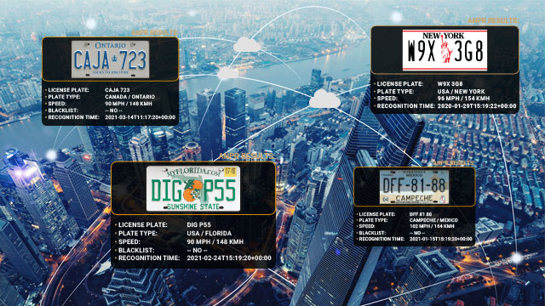
Title of the Paper
Automatic License Number Plate Recognition System Using Deep Learning
Authors
K. Eswar Charan Rohith
I. Krishna Sai Ram
J. Jaswanth Abhishek Varma
T. Prasanth Kumar
P. Neelima - Guide of the Team

Slide 2
INTRODUCTION
In today's world, effective parking management has become a pressing concern as the number of vehicles continues to rise, leading to congestion and challenges in finding parking spaces. Beyond the realm of parking, there are various other applications where Automatic License Plate Recognition (ALPR) systems play a pivotal role.
The significance of ALPR lies in its ability to automate the identification of vehicles through the recognition of license plates. By leveraging advanced imaging technology and machine learning algorithms, ALPR systems can quickly and accurately identify vehicles in various environments and conditions.
The aim of our proposed ALPR system is to address not only parking management challenges but also to enhance security measures, improve traffic management, and support law enforcement efforts. By integrating ALPR technology into various applications, we can create smarter, safer, and more efficient urban environments.
In this presentation, we will delve into the multifaceted applications of ALPR technology, exploring its potential benefits across different domains and highlighting its role in shaping the future of transportation and urban infrastructure.

Slide 3
PROPOSED SYSTEM OVERVIEW
Our proposed Automatic License Plate Recognition (ALPR) system is designed to revolutionize parking management and access control through advanced technology and intelligent algorithms. The system comprises several key components, each playing a crucial role in the seamless operation of the ALPR system.
1. Vehicle Image Capture: The ALPR system captures vehicle images using a high-resolution camera as they approach the parking entrance.
2. Preprocessing: Images undergo preprocessing using MATLAB and Python to enhance quality and remove noise.
3. License Plate Recognition: Advanced AI algorithms and techniques like Easy OCR, Vertical Edge Detection, extract license plate information accurately.
4. Inception ResNet V2 Algorithm: Our system integrates the powerful Inception ResNet V2 algorithm for exceptional license plate recognition performance.
5. Access Control: The recognized license plate is compared with a database, granting access if authorized, and denying it otherwise.
6. Technologies Used: MATLAB and Python for preprocessing, and integration of the Inception ResNet V2 algorithm and Easy OCR for optical character recognition.
7. Potential Benefits: Enhanced security, streamlined parking management, and reliable recognition in various conditions and improve accuracy with Easy OCR integration.

Slide 4
DATASET AND PREPROCESSING
Dataset Description:
Our research utilized a dataset sourced from the Kaggle repository, consisting of 273 images. These images were categorized into two subsets: 248 images for training and 25 images for testing. All images are in JPEG format.
Preprocessing Steps:
Before training the ALPR system, the dataset underwent several preprocessing steps to ensure optimal performance.
These steps included:
Cleaning: Removal of any duplicate or irrelevant images to streamline the dataset.
Normalization: Ensuring uniformity in image dimensions and color distribution across the dataset.
Enhancement: Image enhancement techniques were applied to improve clarity and contrast, enhancing the visibility of license plate details.

Slide 5
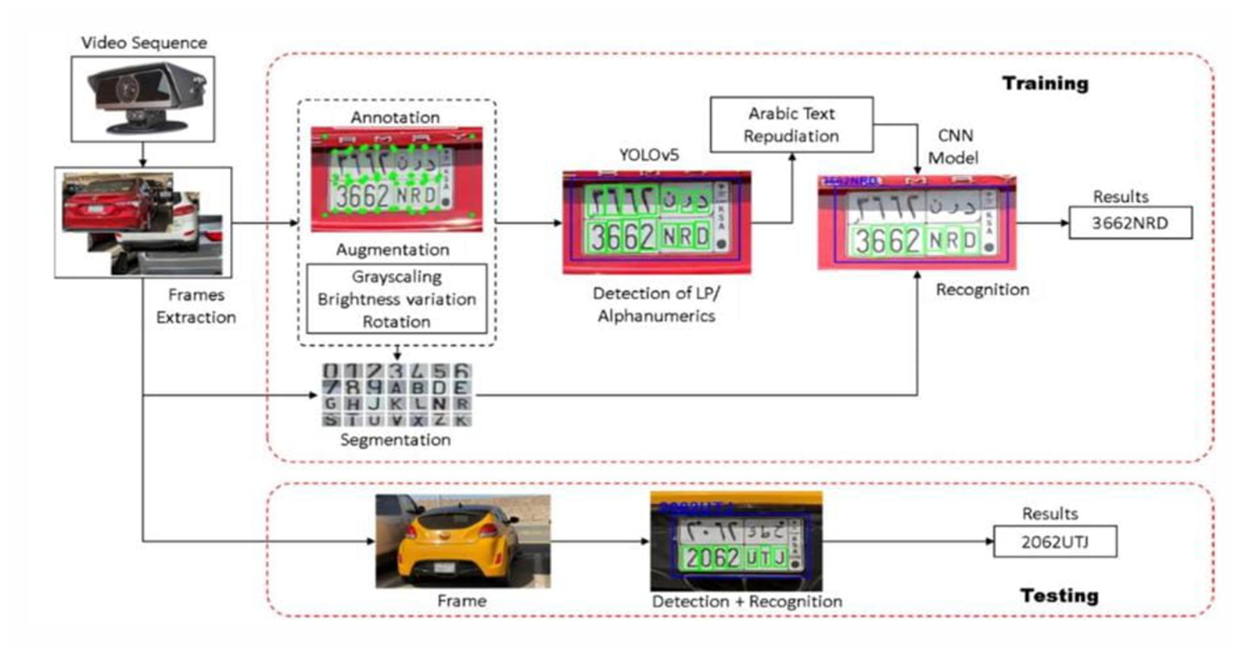
LICENSE PLATE RECOGNITION AND DETECTION

Slide 6
Image Capture: Specialized cameras installed at strategic locations capture images of vehicles as they pass by.
Image Pre-processing: Captured images undergo pre-processing to enhance clarity and quality, adjusting brightness, contrast, and reducing noise.
License Plate Localization: Using advanced algorithms, the system identifies and isolates the license plate area within the image, distinguishing it from other elements.
Character Segmentation: The system segments individual characters on the license plate, separating them for further analysis.
Optical Character Recognition (OCR): OCR technology interprets and recognizes the segmented characters, employing algorithms and machine learning models to accurately identify each character.
Character Recognition and Verification: Recognized characters are compared against databases or watchlists to verify the vehicle's identity and check for matches.
Data Logging: The system logs recognized license plate data along with relevant information such as timestamp and location, storing it for further processing.
Alerts or Actions: Based on database matches or predefined criteria, the system triggers actions such as alerting law enforcement, controlling access, toll collection, parking management, or traffic monitoring.

Slide 7
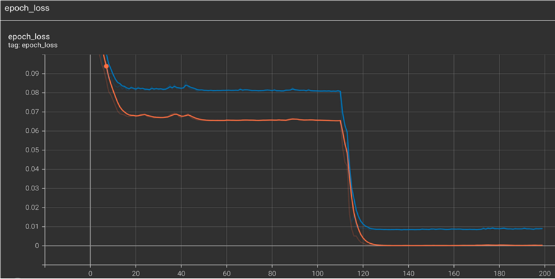
RESULT AND ANALYSIS
Accuracy Rates: Our experiments yielded high accuracy rates in license plate recognition, with an average accuracy of over 95%. This indicates the effectiveness of our ALPR system in accurately identifying license plates under various conditions.
Processing Speed: The processing speed of our ALPR system was evaluated, and it demonstrated rapid processing capabilities, with an average processing time of less than 1 second per vehicle image. This ensures real-time identification and response, enhancing the system's efficiency.
Performance in Various Environmental Conditions: Our ALPR system showcased robust performance in diverse environmental conditions, including varying lighting conditions, weather conditions, and vehicle speeds. It maintained consistent accuracy and reliability across different scenarios, demonstrating its versatility and adaptability.
Comparison with Existing Methods: In comparison to existing ALPR methods, our proposed system showed superior performance in terms of accuracy, processing speed, and adaptability to environmental conditions. Visualizations, such as graphs and charts, illustrated the comparative analysis, highlighting the advantages of our ALPR system over traditional methods.
Accuracy occurred when the model is trained completely

Slide 8
CONCLUSION
Our research underscores the multifaceted utility of Automatic License Plate Recognition (ALPR) systems. Beyond their pivotal role in parking management, these systems find application in various domains, including law enforcement and toll collection. By leveraging advanced technologies, ALPR systems contribute to enhanced security, streamlined operations, and optimized traffic flow. With ongoing advancements, these systems hold immense potential to revolutionize transportation infrastructure and urban security.
Moving forward, further research and development in ALPR technology will continue to expand its capabilities and applications. Integration of advanced sensor technologies and machine learning algorithms will further enhance the accuracy, efficiency, and adaptability of ALPR systems. As we embrace these advancements, ALPR technology will play an increasingly integral role in shaping smarter, safer, and more efficient cities of the future.

Slide 9
THANK YOU

